Slide 1

Bài 13: Spring Basic
Giảng viên: Nguyễn Quang Huy
Email: HuyNQ12@topica.edu.vn
‹#›

Slide 2
Differences between Java EE and Java SE
Java technology is both a programming language and a platform
The Java programming language is a high-level object-oriented language that has a particular syntax and style
A Java platform is a particular environment in which Java programming language applications run
There are four platforms of the Java programming language
Standard Edition (Java SE)
Enterprise Edition (Java EE)
Micro Edition (Java ME)
JavaFX
‹#›

Slide 3
The Java Programming Language Platforms
Standard Edition
provides core functionality
defines basic types and objects, high-level classes that are used for networking, security, database access, graphical user interface (GUI) development, and XML parsing
consists of a virtual machine, development tools, deployment technologies, and other class libraries and toolkits
Enterprise Edition
built on top of the Java SE platform
provides an API and runtime environment for developing and running large-scale, multi-tiered, scalable, reliable, and secure network applications
‹#›

Slide 4
The Java Programming Language Platforms (continue)
Micro Edition
provides an API and a small-footprint virtual machine for running Java programming language applications on small devices, like mobile phones
a subset of the Java SE API, along with special class libraries useful for small device application development
often clients of Java EE platform services
JavaFX
a platform for creating rich internet applications using a lightweight user-interface API
use hardware-accelerated graphics and media engines to take advantage of higher-performance clients and a modern look-and-feel as well as high-level APIs for connecting to networked data sources
may be clients of Java EE platform services
‹#›

Slide 5
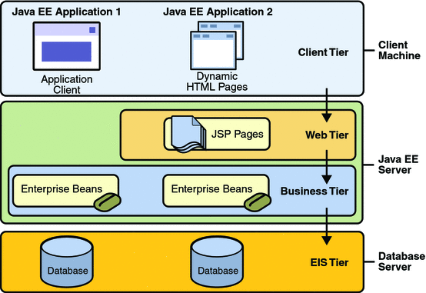
Java EE - Distributed Multitiered Applications
‹#›
Notes:
Considered to be three-tiered applications because they are distributed over three locations
Three-tiered applications that run in this way extend the standard two-tiered client-and-server model by placing a multithreaded application server between the client application and back-end storage.
Refference https://javaee.github.io/tutorial/overview004.html

Slide 6
Java EE - Security
Enables security constraints to be defined at deployment time
Applications portable to a wide variety of security implementations by shielding application developers from the complexity of implementing security features
Provides standard declarative access control rules that are defined by the developer and interpreted when the application is deployed on the server
Provides standard login mechanisms so that application developers do not have to implement these mechanisms in their applications
‹#›

Slide 7
Java EE - Components
Java EE applications are made up of components
A Java EE component is a self-contained functional software unit that is assembled into a Java EE application with its related classes and files and that communicates with other components
Application clients and applets are components that run on the client
Java Servlet, JavaServer Faces, and JavaServer Pages (JSP) technology components are web components that run on the server.
EJB components (enterprise beans) are business components that run on the server
Java EE components are assembled into a Java EE application, they are verified to be well formed and in compliance with the Java EE specification, and they are deployed to production, where they are run and managed by the Java EE server
‹#›

Slide 8
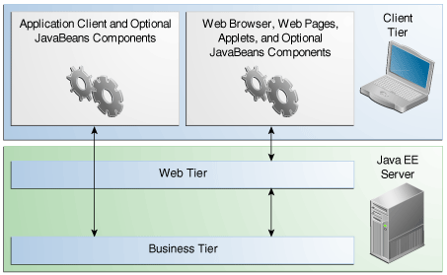
Java EE - Clients
Web Clients consists of two parts
Dynamic web pages containing various types of markup language (HTML, XML, and so on), which are generated by web components running in the web tier
A web browser, which renders the pages received from the server
Application Clients
provides a way for users to handle tasks that require a richer user interface than can be provided by a markup language
Applets
a small client application that executes in the Java virtual machine installed in the web browser
‹#›

Slide 9
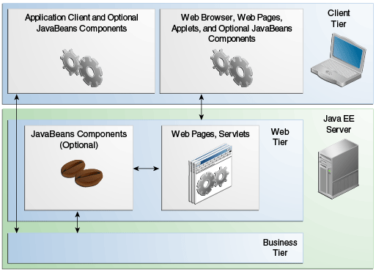
Java EE - Web Components
Are either servlets or web pages created using JavaServer Faces technology and/or JSP technology (JSP pages)
Servlets are Java programming language classes that dynamically process requests and construct responses
JSP pages are text-based documents that execute as servlets but allow a more natural approach to creating static content
JavaServer Faces technology builds on servlets and JSP technology and provides a user interface component framework for web applications
Might include a JavaBeans component to manage the user input and send that input to enterprise beans running in the business tier for processing
‹#›

Slide 10
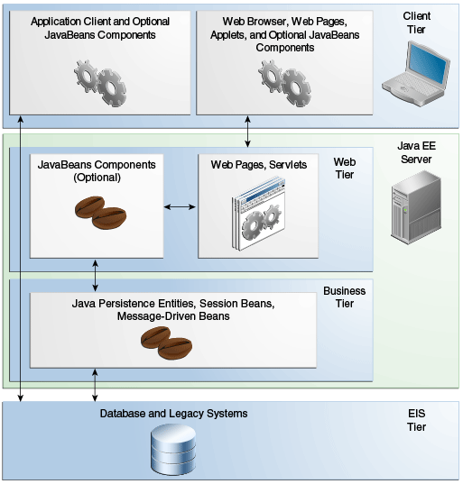
Java EE - Business Components
Business code, which is logic that solves or meets the needs of a particular business domain such as banking, retail, or finance, is handled by enterprise beans running in either the business tier or the web tier
‹#›

Slide 11
Java EE - Enterprise Information System Tier
The enterprise information system tier handles EIS software and includes enterprise infrastructure systems, such as enterprise resource planning (ERP), mainframe transaction processing, database systems, and other legacy information systems. For example, Java EE application components might need access to enterprise information systems for database connectivity.
‹#›

Slide 12
What’s MVC?
‹#›

Slide 13
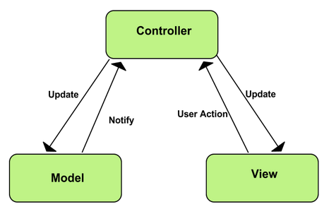
MVC pattern
Stand for Model-View-Controller
Model
represents an object or JAVA POJO carrying data
can also have logic to update controller if its data changes
View
represents the visualization of the data that model contains
Controller
acts on both model and view
controls the data flow into model object and updates the view whenever data changes
keeps view and model separate
‹#›
Notes:
https://www.tutorialspoint.com/design_pattern/mvc_pattern.htm

Slide 14
What’s WEB MVC?
‹#›

Slide 15
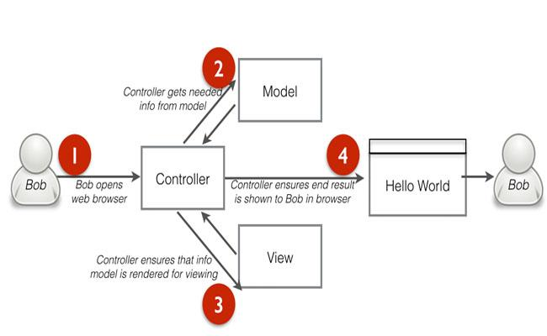
‹#›
Notes:
test online → https://www.javatpoint.com/directload.jsp?val=92

Slide 16

‹#›

Slide 17
Task
Build an Vietnamese - English dictionary application use Java EE
Business requirements:
Allow user search by type in textbox then show result in table
Allow admin import data for dictionary by upload new file
Allow search by “tiếng Việt có dấu hoặc không dấu”
Technical requirement
Use GlassFish
Dictionary store in MySQL
Bonus: use JavaServer Faces, use Java Persistence API (JPA), use & explain Contexts and Dependency Injection for Java EE, use Java Authorization Contract for Containers
‹#›

